Slide 1

cancer
S
K
I
N
MACHINE LEARNING

Slide 2
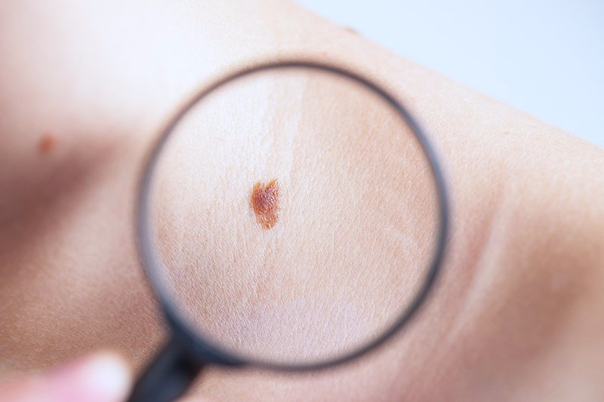
Architecture used in the Paper:
Multiclass skin cancer classification using Efficient-Nets
a first step towards preventing skin cancer.

Slide 3
Dataset Details
Dataset:
Augmented Skin Cancer ISIC.
No. of Samples: 9118 & No. of Classes: 9 .
Skin Cancer Classes:
1 – Actinic Keratosis 2 – Basal Cell Carcinoma 3 – Dermatofibroma
4 – Melanoma 5 – Pigmented Benign Keratosis 6 – Nevus
7 – Seborrheic Keratosis 8 – Squamous Cell Carcinoma 9 – Vascular Lesion

Slide 4
Implementation Details:
 |  | 1st model | 2nd model | 3rd model
Hyperparameters used:
Initial learning rate | 0.001 | 0.001 | 0.001 | 0.0001
Include top | True | True | False | -
Shape | (224, 224, 3) | (224, 224, 3) | (224, 224, 3) | -
Weights | None |  | ImageNet | -
Optimizer | Adam | Adam | Adam | Adam
Loss | Sparse Categorical Crossentropy | Sparse_categorical_crossentropy | Sparse Categorical Crossentropy | Sparse Categorical Crossentropy
Batch size | 32 | 32 | 32 | 32
Epoch size | 40 | 20 | 25 | 10
Learning rate | - |  | 0.0001 | 0.0001
Batch normalization | - |  | - | √
Regularization dropout | - |  | 0.2 | -
Average Pooling | - |  | √ | -

Slide 5
Results and visualizations:
Accuracy:
 | 1st model | 2nd model | 3rd model
Test | 63% | 50% | 69.7%
Train | 68% | 51% | 74%
Validation | 61% | 49% | 69%
Test accuracy:
In 2nd model :
Evaluated model in weight to be ImageNet, added Regularization Dropout 20%, updated learning rate to 0.0001 and added Average pooling
In 3rd model:
We transferred the learning and added Batch Normalization

Slide 6
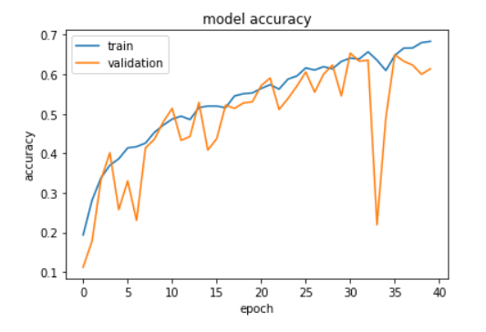
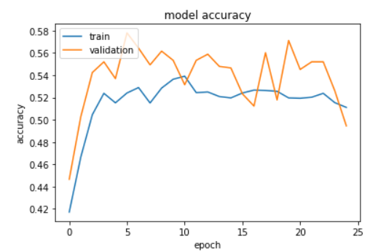
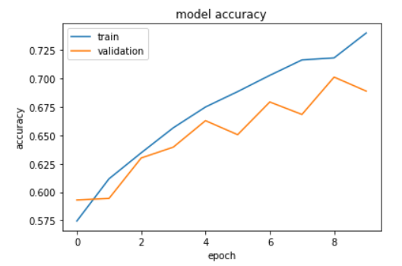
Learning Curves
MODEL 1
MODEL 2
MODEL 3

Slide 7
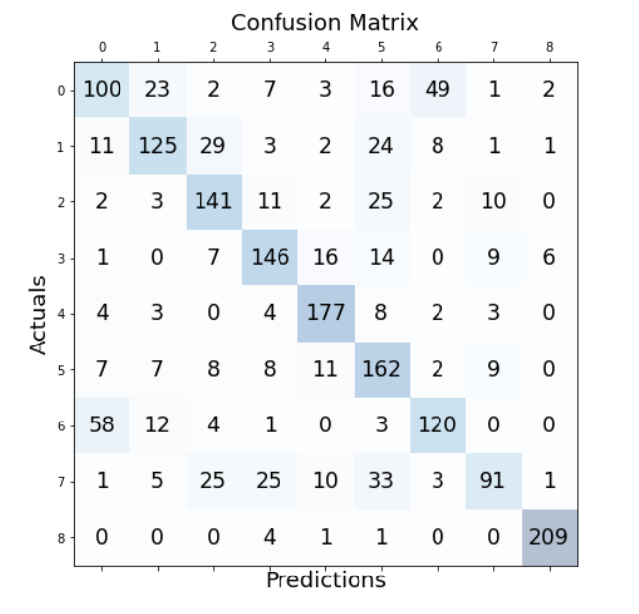
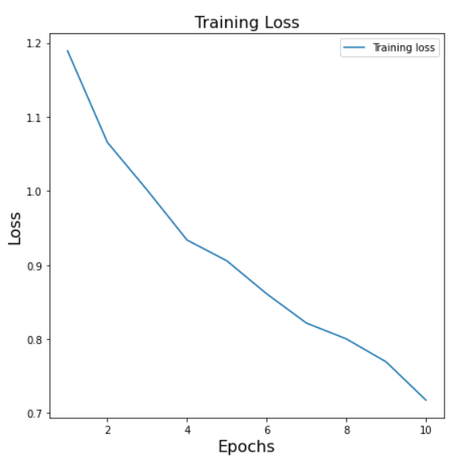
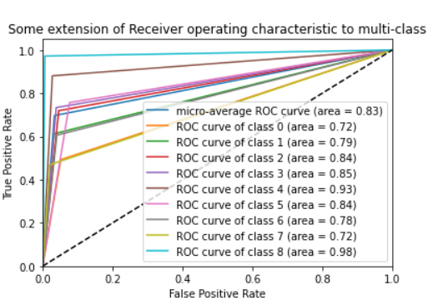

Slide 8
Thank you

